Slide 1

Semiconductor Visualization
Hanoi University of Science and Technology
School of Information and Communication Technology
Object-oriented Programming – 20192

Slide 2
Team members & Assignments
Name | Student ID | Tasks
Trinh Thu Hai | 20184255 | Design ideas Design class diagram & use-case diagram Implement backend codes Test backend Suggest modifications to frontend Integrate frontend and backend code
Nguyen Thi Minh Chau | 20184238 | Design ideas Design class diagram & use-case diagram Implement frontend codes & design GUI Test frontend and GUI Suggest modifications to backend Final test Write documents, preparing video & presentation slides.
Notes:
Team member assignments

Slide 3
PROBLEM STATEMENT
Object-oriented is a new programming method which is convenient but difficult for new learners to master.
The aim of the project is to use this technique to build a program for visualizing fundamental working principles of semiconductors materials – not only for applying knowledge in OOP to real application, but also to give a better knowledge for learner about semiconductors.
Notes:
Problem statement

Slide 4
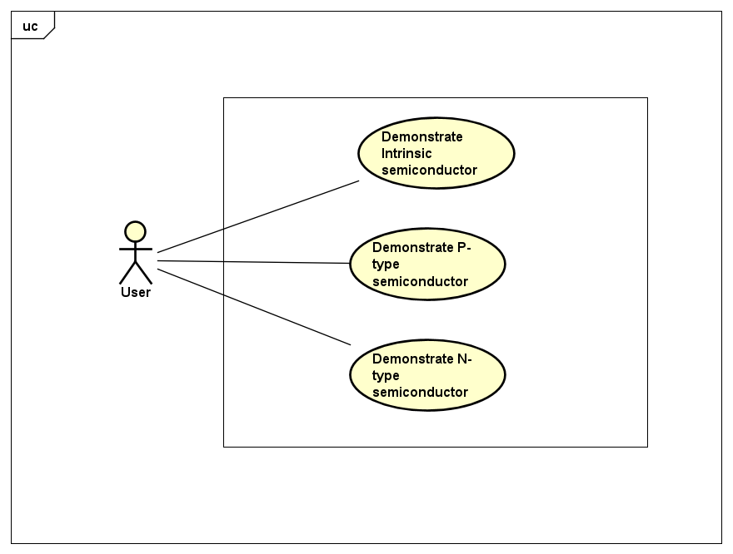
Notes:
Use-case diagram

Slide 5
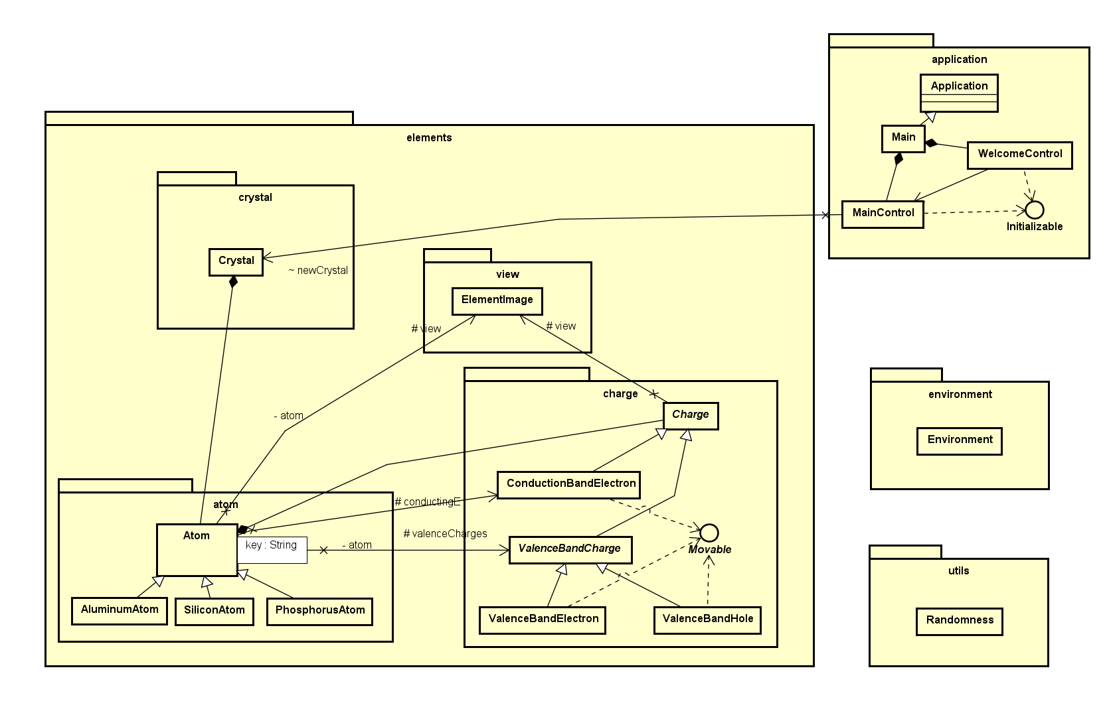

Slide 6
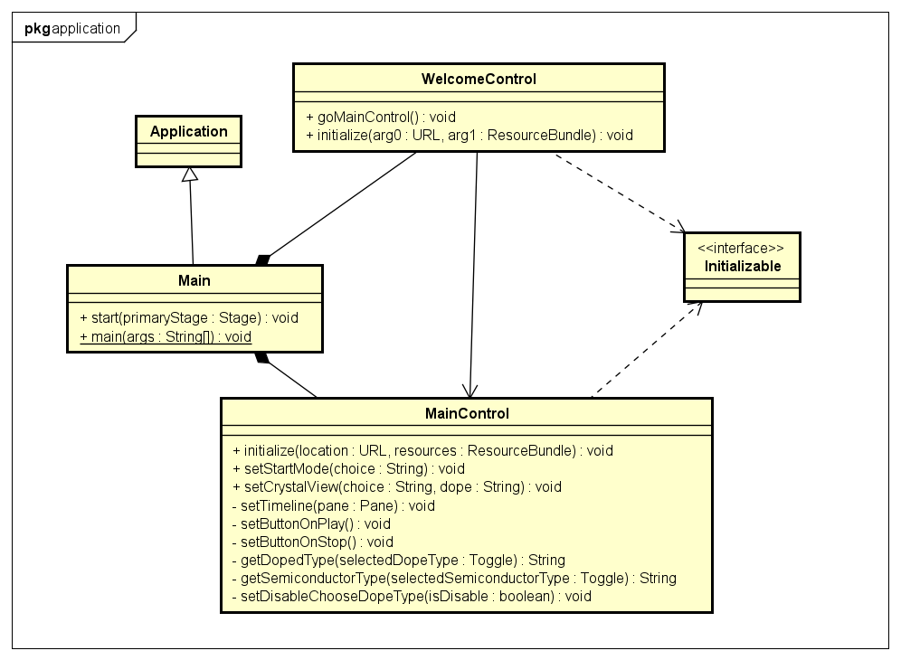
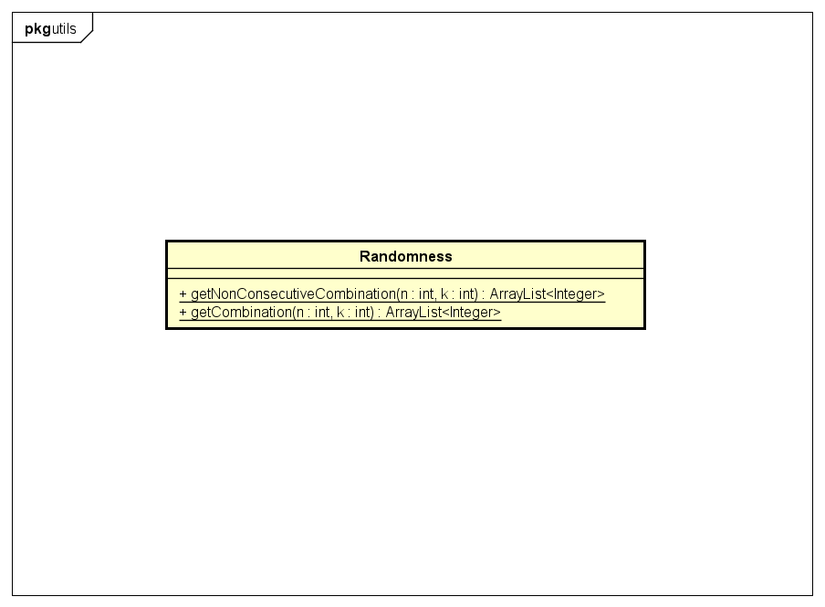
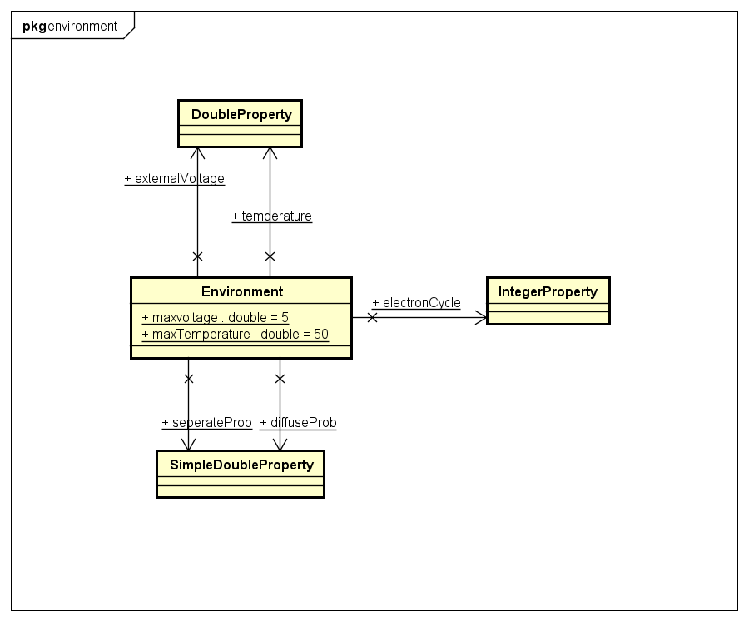
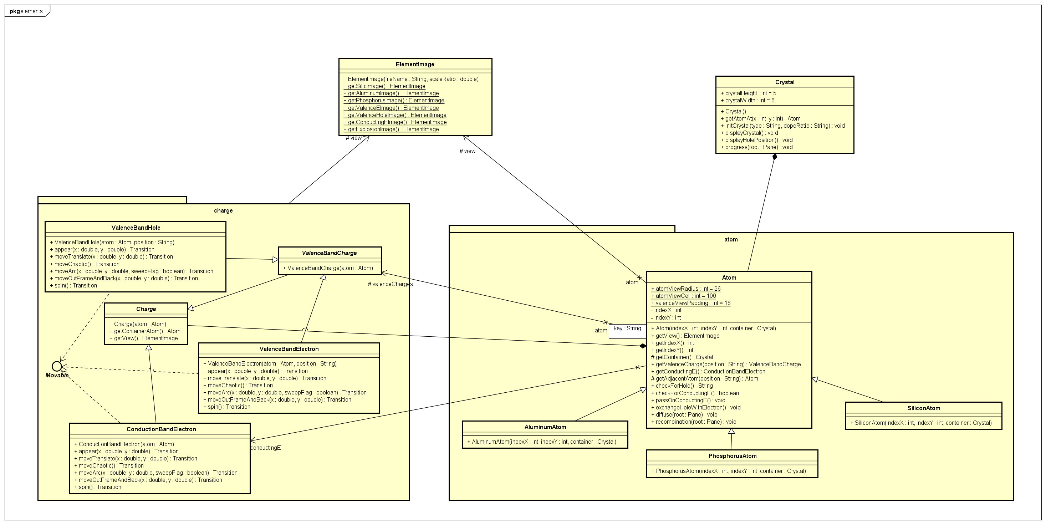
Notes:
Class diagram for packages and modules

Slide 7

Notes:
Demo video with link

Slide 8
Questions & Answers

Slide 9


